Slide 1
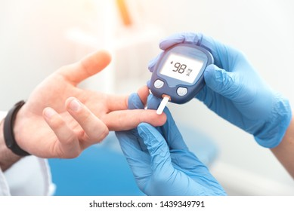

DIA(β)ES PREDICTION
A comparative approach through machine learning.
Fergusson College (Autonomous)
Department of Statistics. T.Y. B.Sc. Project 2020-21

Slide 2
D I A B E T E S
Introduction & Motivation
Diabetes is a disease that occurs when your blood glucose, also called blood sugar, is too high and the relative change in other body factors .It contains three of its types and the patient gets diagnosed to one of those based on different types of human factors. As per International Diabetes Federation (IDF), India is one of the participants with more diabetic people. It is reported that about 72 million people are affected by diabetes in 2017-18. Though the diabetes is not fatal, it is not curable, and the ill-effects continue till the lifetime of patient. Hence, it is better to predict rather than treat the disease. So here we are going to do similar kind of thing using different models of machine learning.
here with the use of statistical learning , we are going to predict the condition of patient by providing some basic variables of human body to the machine and concluding the output.

Slide 3
ABSTRACT
In this project we attempt to predict diabetes in patients by using different statistical models such as Naive Bayes, K-Nearest Neighbours, Random Forest, Logistic regression, Decision Trees, Support Vector Machine(linear and radial). There are 9 variables used in this classification which are pregnancies (no of times pregnant), glucose, blood pressure, skin thickness, BMI, insulin, age, diabetes pedigree function, and outcome. The 7 models are compared using metrics such as accuracy, AUC, sensitivity and specificity. In the process we obtain their confusion matrices and ROC curves. Our aim is to find the model which is best suited for predicting this data. Exploratory analysis has also been done to get a feel for the data and to detect any obvious relationships that might exist.

Slide 4
OBJECTIVES
The objective of the dataset is to diagnostically predict whether or not a patient has diabetes, based on certain diagnostic measurements included in the dataset.
We will build and train following machine learning models during this analysis.
1. Naive Bayes
2. K-Nearest Neighbours
3. Random Forest
4. Logistic Regression
5. Decision Trees
6. Support Vector Machine

Slide 5
Data Source
Secondary data is collected from following address: https://www.kaggle.com/mathchi/diabetes-data-set. This dataset is originally from the National Institute of Diabetes and Digestive and Kidney Diseases. In particular, all patients here are females at least 21 years old of Pima Indian heritage.
Number of Instances: 768 (all numeric-valued) Number of Attributes: 8
Pregnancies: Number of times pregnant
Glucose: Plasma glucose concentration a 2 hours in an oral glucose tolerance test
Blood Pressure : Diastolic blood pressure (mm Hg)
Skin Thickness : Triceps skin fold thickness (mm)
Insulin: 2-Hour serum insulin (mu U/ml)
BMI: Body mass index (weight in kg/(height in m)^2)
DiabetesPedigreeFunction: Diabetes pedigree function
Age: Age (years)
Outcome: Class variable (0 or 1)

Slide 6
Methodology
Collection of Data
Analyzing Data
Data Wrangling
Train and Test
Accuracy
Confusion Matrix
Sensitivity
Specificity
Roc curve
Comparison

Slide 7
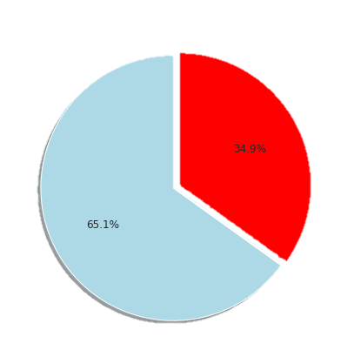
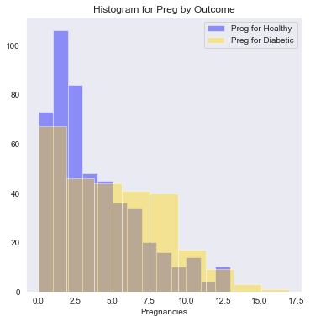
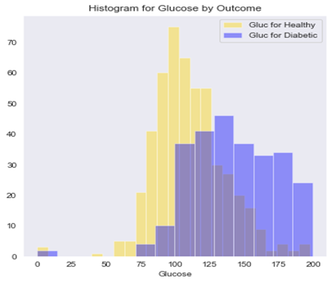
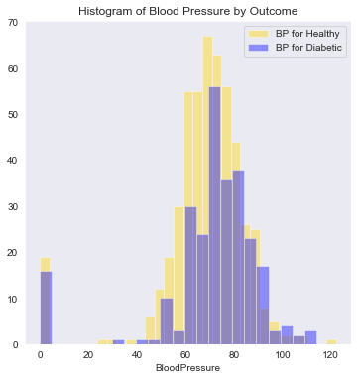
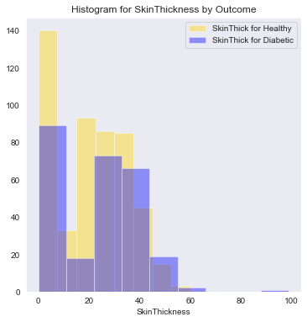
EXPLORATORY DATA ANALYSIS
Healthy vs. Diabetic by Pregnancy
Healthy vs. Diabetic by Glucose
Healthy- 65%
Diabetic- 35%
Healthy vs. Diabetic by Blood Pressure
Healthy
vs. Diabetic by Skin Thickness
Similarly we can comment about other variables also.

Slide 8
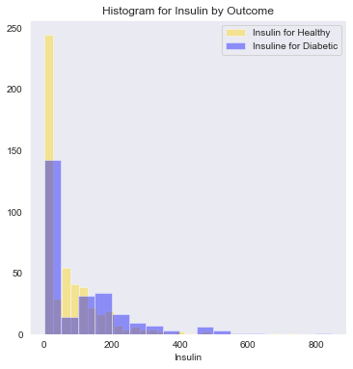
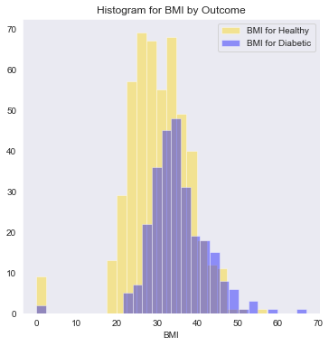
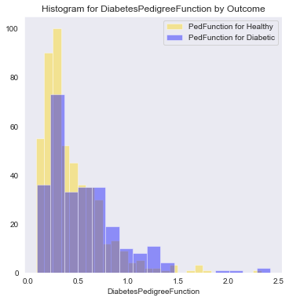
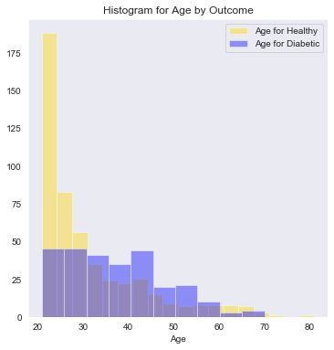
Healthy vs. Diabetic by Insulin
Healthy vs. Diabetic by BMI
Healthy vs. Diabetic by Diabetes Pedigree Function
Healthy vs. Diabetic by Age

Slide 9
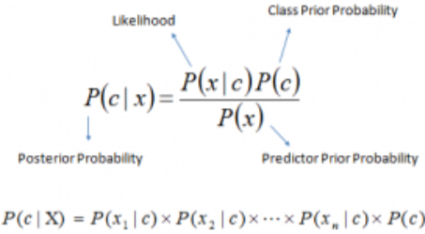
Model Analysis
-Naive Bayes
Naive Bayes classifiers are a collection of classification algorithms based on Bayes’ Theorem. ‘Naive Bayes’ theorem provides a way of calculating posterior probability P(c|x) from P(c),
P(x) and P(x|c). Naive Bayesian equation to calculate the posterior probability for each class. The class with the highest posterior probability is the outcome of prediction.
- K-Nearest Neighbours (K-NN)
K-NN is based on feature similarity i.e., it is going to look around and look at the feature and check how similar I am as compared to my neighbours. K-NN algorithm assumes the similarity between the new case/data and available cases and puts the new case into the available category that shows the most similarity. It is going to take the K nearest neighbours as per the calculated Euclidean distance. Among these K neighbours, count the number of the data points in each category. Assign the new data points to that category for which the number of the neighbour is maximum.

Slide 10
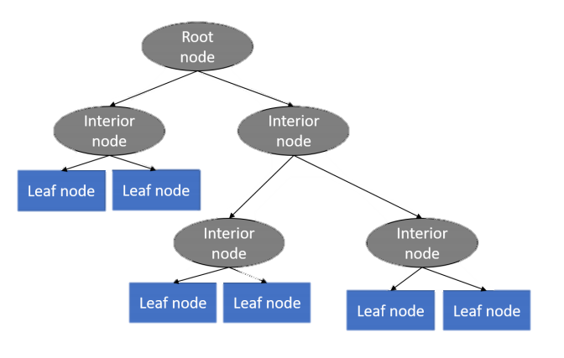
-Decision Trees
A decision tree is a decision support tool that uses a tree-like structure starts with the root node at the top, the root node, where the process of decision-making starts. Under the Root nodes are decision nodes. They can have two or more branches as per needed. Lastly comes the Leaf nodes which represents the classification or decision of the instance. A tree can be “learned” by splitting the source set into subsets based on an attribute value test. This process is repeated on each derived subset in a recursive manner called recursive partitioning. The recursion is completed when the subset at a node all has the same value of the target variable, or when splitting no longer adds value to the predictions.

Slide 11
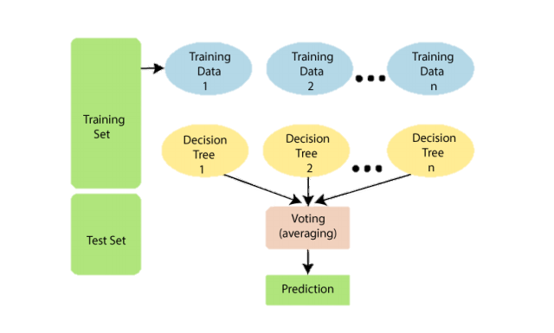
-Random Forest
Random Forest is a classifier that contains a number of decision trees on various subsets of the given dataset and takes the average to improve the predictive accuracy of that dataset. Instead of relying on one decision tree, the random forest takes the prediction from each tree and based on the majority votes of predictions, and it predicts the final output.

Slide 12
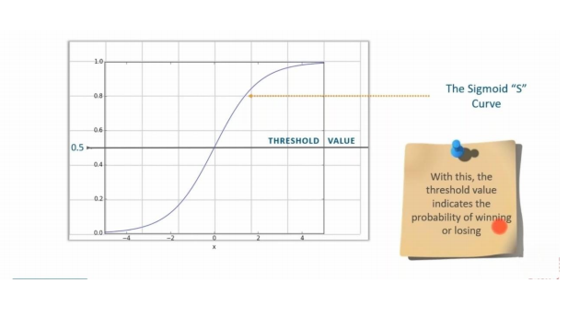
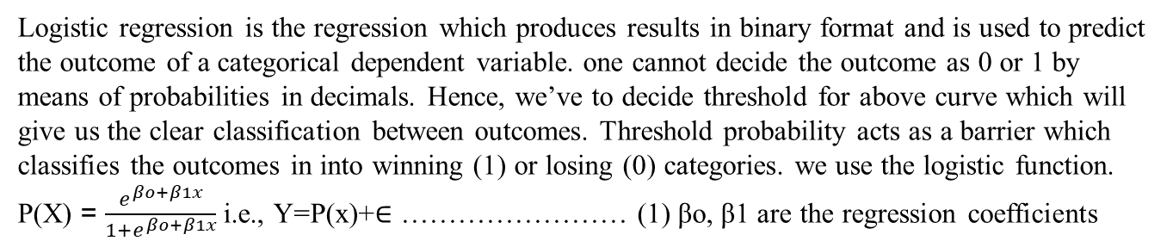
-Logistic Regression
Logistic regression is the regression which produces results in binary format and is used to predict the outcome of a categorical dependent variable. one cannot decide the outcome as 0 or 1 by means of probabilities in decimals. Hence, we’ve to decide threshold for above curve which will give us the clear classification between outcomes. Threshold probability acts as a barrier which classifies the outcomes in into winning (1) or losing (0) categories. we use the logistic function. P(X) = $\frac{e^{βo+β1x}}{{1+e}^{βo+β1x}}$i.e., Y=P(x)+∈ …………………… (1) βo, β1 are the regression coefficients

Slide 13

-Support Vector Machine
In the SVM algorithm, we plot each data item as a point in n-dimensional space (where n is number of features you have) with the value of each feature being the value of a particular coordinate. Then, we perform classification by finding the hyper-plane that differentiates the two classes very well. Once the plane is found we check our where our new data point lies and conclude accordingly as healthy or diabetic.

Slide 14
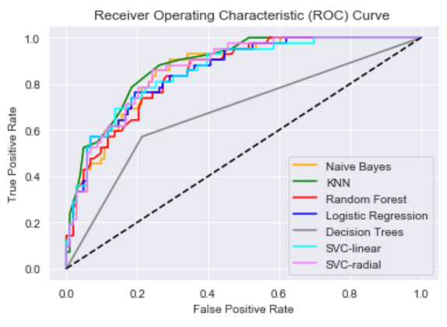
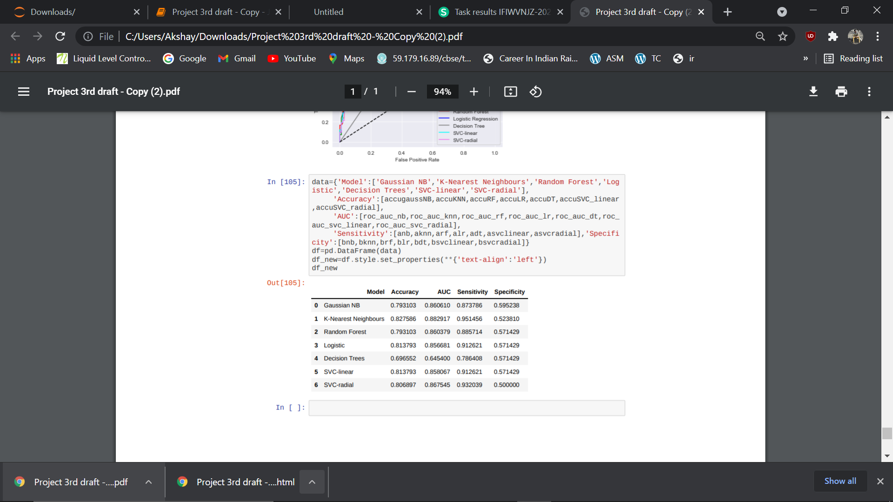
INTERPRETATION
Here, we can see that the Accuracy(82.76%) , AUC(88.29%) and the sensitivity (95.15%) value for K-NN model is the highest among other models. Also from the ROC curve we can see similar results as the area under the curve is the maximum for K-NN model.

Slide 15
CONCLUSION
The objective of this project was to predict diabetes using 7 basic statistical machine learning techniques. As we can see from the previous comparison that for our data, K-NN (K- Nearest Neighbours) is the best classifier, So we suggest to use K-NN classifier to predict diabetes among those 7 techniques.

Slide 16
SCOPE
In co-ordination with the project, it will be useful to predict the accuracy of different statistical models and comparative study of them in order to predict the predisposition of a subject to diabetes. Such is the power of statistical learning that without much medical knowledge, and relying just on past patients’ data, a statistician is in a position to build surprisingly accurate prediction models. A possible application would be to create an app that predicts diabetes. This would help to reach out to masses and to spread awareness. Methods used in this project can be applied to other areas of medicine as well. The scope of the project goes as far as one can take it with better understanding of machine learning, improved techniques and sophisticated algorithms, thus transforming the future of medical diagnosis for the better.

